Slide 1

The Product-Minded Engineer in the Age of AI-Driven Development.

Slide 2
01
02
03
04
05
The Traditional View of Engineers
The Product-Minded Engineer
Becoming a More Product-Minded Engineer
Common Misconceptions
Age of AI-Driven Development
Pag. 3
Pag. 7
Pag. 12
Pag. 18
Pag. 20

Slide 3
The Traditional View of Engineers
01

Slide 4
The Traditional View of Engineers
Engineering Education Today
Build-first education Heavy emphasis on implementation and technical fundamentals.
Engineering rigor Algorithms, system design tradeoffs, and efficiency optimization.
Problem decomposition breaking complex work into structured steps.
Analytical thinking logic, critical reasoning, and correctness-focused mindset.

Slide 5
The Traditional View of Engineers
Engineers in Traditional Organizations
Execution-first role Engineers are brought in to implement predefined requirements.
Separation of thinking and building Product decides what, engineering focuses on how.
Optimization over intent Deep focus on performance, scalability, and efficiency—not why.
Linear delivery model Handoffs, late feedback, and limited direct customer insight.

Slide 6

The Traditional View of Engineers
Engineers that Stand Out
Broader focus Strong interest in the product’s value to users and the business.
Dual perspective Identify both engineering challenges and product problems.
Problem-oriented mindset Move beyond code delivery to solving real user needs.
They are product-minded engineers.
"Good engineering isn’t just about coding, it’s about asking the right questions.“

Slide 7
The Product-Minded Engineer
02

Slide 8
The Product-Minded Engineer
Product Understanding
As a PM
Curiosity and a keen interest in "why?" Ask questions. Listened.
Interest in the business
Understand how the end-user uses the product that you built User behavior and data.
Embrace their curiosity
Give them direct exposure to customers
Never do customer research or interviews without engineers

Slide 9
The Product-Minded Engineer
Product Judgment
As a PM
Proactive with product ideas/opinions
Offering product/engineering tradeoffs upfront
Practical handling of edge cases
Bring healthy conflict
Embrace this. They’re questioning the work, not you as a person
They are not trying to take your job or replace you. They’re just helping you
Start by assuming they’re onto something, rather than seeking to defend your point of view
It’s not rebellion. It’s a sense of ownership. They care about the product

Slide 10
The Product-Minded Engineer
Feedback
As a PM
Seek early feedback
Quick product validation cycles A/B testing is one of the tools.
Strong product instincts through repeated cycles of learning Google Analytics and monitoring the error reporting tools.
Empower engineers to have direct exposure to those feedback loops
Empower product-minded engineers with responsibility to triage incoming feedback

Slide 11
The Product-Minded Engineer
Collaboration
As a PM
Strong communicator
Great relationships with non-engineers
End-to-end product feature ownership After rollout, they still actively engage with product managers, data scientists, and customer support channels, to learn how the feature is being used in the real world. It can take weeks to get enough reliable data to draw conclusions.
Encourage engineers to share their learnings
Work on draft content alongside the engineers
Give them opportunities to present to stakeholders

Slide 12
Becoming a More Product-Minded Engineer
03

Slide 13
Becoming a More Product-Minded Engineer
Understand how and why your company is successful
What is the business model?
How is money made?
What parts are most profitable, what parts of the company are expanding the most?
Why?
How does your team fit into all of this?
Who are our users?

Slide 14
Becoming a More Product-Minded Engineer
Build a strong relationship with your product manager
Proactive partnership Build trust and a working relationship early.
Leverage PM mentorship Product managers often welcome engineers’ product curiosity.
Ask better questions Engage before implementation, not just during delivery.
Signal intent Clearly communicate your desire to be involved in product decisions.

Slide 15
Becoming a More Product-Minded Engineer
Engage in user research, customer support, and other activities
Get closer to users Participate in research, support, and feedback channels.
Learn through exposure Observe how the product is actually used in practice.
Cross-functional pairing Work with design, UX, data, and operations.
Context over assumptions Replace second-hand requirements with direct insight.

Slide 16
Becoming a More Product-Minded Engineer
Bring well-backed product suggestions to the table
Take initiative Proactively propose improvements, not just implementations.
Start small Validate ideas within the scope of your current projects.
Think end-to-end Frame suggestions in both product value and engineering effort.
Enable prioritization Make tradeoffs explicit so ideas fit naturally into the backlog.

Slide 17
Becoming a More Product-Minded Engineer
Offer product/engineering trade-offs
Go beyond technical tradeoffs Consider product alternatives, not just implementation choices.
Reduce effort through scope suggest simpler product options with similar user value.
Make tradeoffs explicit clarify impact on cost, complexity, and outcomes.
Invite feedback treat tradeoff discussions as collaborative, not prescriptive.

Slide 18
Common Misconceptions
04

Slide 19
Common Misconceptions
01 /
Product Minded ≠ Product Manager
Engineers do not replace PMs; they complement them. PMs focus on the bigger picture.
02 /
Product Minded ≠ Saying “Yes” to Everything
In fact, product-minded engineers often advocate for less.
03 /
Product Minded ≠ Code Quality Doesn't Matter
NOSENSE!!! Remember, the Clean Code will always matter - the code quality is part of the engineering. Even in the Age of the AI-Driven Development.

Slide 20
Age of AI-Driven Development
05

Slide 21



Age of AI-Driven Development
How AI Supports Engineering
Execution acceleration AI generates boilerplate, prototypes, tests, and translations.
Code assistance Helps read, refactor, review, and work with legacy code.
Workflow support Assists with PR reviews, CI/CD, and developer productivity.
Human oversight required AI executes fast, but engineers provide context, judgment, and direction.
AI is like a junior engineer on 10 Red Bulls: It writes code at light speed, but only exactly what it is asked to write, without understanding the bigger picture.
This is where human engineers must lead the process through guidance, monitoring, and supervision.

Slide 22
Age of AI-Driven Development
Product-Minded Engineers and AI-Driven Development
Shift the focus When the big part of execution is automated, the engineers can focus more on other topics like product thinking.
Product context matters more AI lacks user intent and business awareness.
Amplified impact Strong product thinking turns AI speed into real value.
Leverage through direction Product-minded engineers using the product knowledge guide the AI easier toward the right outcomes.

Slide 23
Age of AI-Driven Development
The Future Belongs to Product-Minded Engineers
The Product-minded engineers is even more needed in the AI-driven development where we'll have more time to focus on the product.
In an age where AI handles the syntax, engineers who master user empathy and product thinking will define the future of software.
Product-minded engineers will outperform other engineers in an AI-accelerated world.

Slide 24

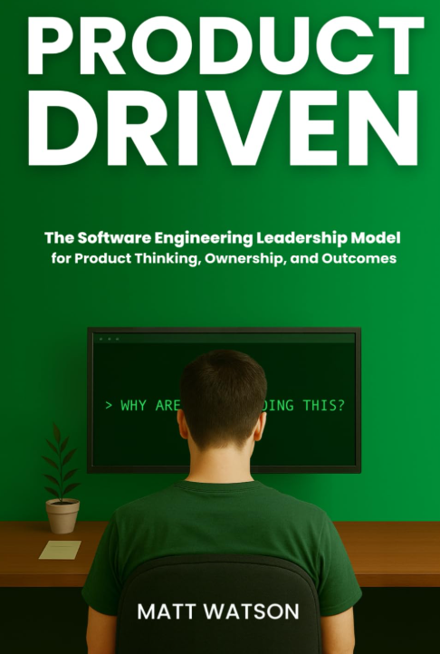
Resources
Focused on the engineer’s mindset, decision-making, and product impact.
A product-centric perspective on how teams and organizations build and scale software products.
Bad: the book underplays the importance of code quality, positioning it as secondary to speed and execution

Slide 25
Thank you!

